Slide 1
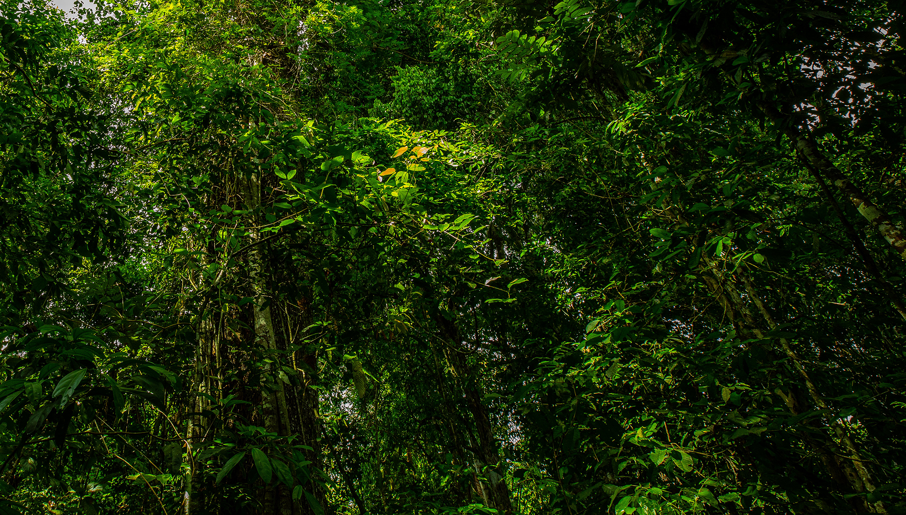

Slide 2
GREEN BRAZILIAN INDUSTRY
SUSTAINABLE INITIATIVE
DEVELOPING A SUSTAINABLE SOLID-STATE BATTERY INDUSTRY IN BRAZIL

Slide 3
BRAZIL
SOUTH AMERICA
BRAZILIAN INDUSTRY
GREEN PROJECTS

Slide 4
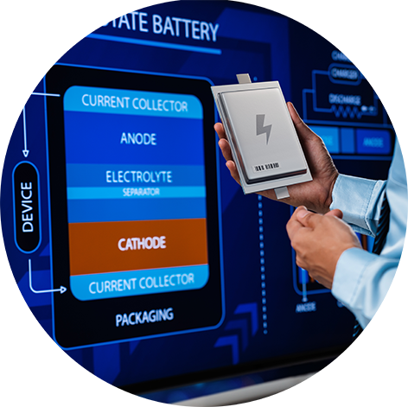
GREEN | BRAZILIAN INDUSTRY
DEVELOPING A SUSTAINABLE SOLID-STATE BATTERY INDUSTRY IN BRAZIL
OBJECTIVE
To design and produce a sustainable solid-state battery in Brazil to lower production costs, reduce GHG emissions, avoid the use of cobalt, and strengthen a sustainable supply chain in the context of a circular economy.
DESCRIPTION
Development of a sustainable solid-state battery industry in Brazil, comprising the design and production of a solid-state battery that is environmentally friendly, cost-effective, and socially responsible.
Includes research and development, production scale-up, and the establishment of a sustainable supply chain for the production of SSB.

Slide 5
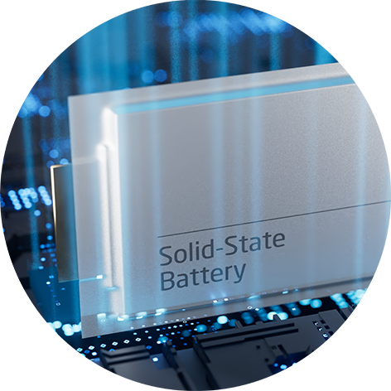
GREEN | BRAZILIAN INDUSTRY
DEVELOPING A SUSTAINABLE SOLID-STATE BATTERY INDUSTRY IN BRAZIL
KEY ACTIVITIES
Conduct market studies for solid-state batteries.
Conduct research and development work.
Establish a pilot production line for the SSB, and optimize the production process to reduce costs and increase efficiency.
Scale up production and establish partnerships with suppliers and manufacturers.
Develop and implement a circular economy strategy for the production of the battery, with the use of recycled materials and a closed-loop production process.
Conduct outreach and communication activities on the benefits of SSB.

Slide 6
GREEN | BRAZILIAN INDUSTRY
DEVELOPING A SUSTAINABLE SOLID-STATE BATTERY INDUSTRY IN BRAZIL
EXPECTED OUTCOMES
Development of a solid-state battery industry in Brazil
Establishment of a sustainable supply chain for solid-state batteries production (focus on a circular economy and the use of recycled materials)
Reduction in GHG emissions associated with the production of solid-state batteries
Creation of new jobs and economic growth
Partnerships with other countries to promote the development of a value chain for SSB production.
PROJECT COSTS
TIMELINE
US$ 20 MILLION
4 YEARS

Slide 7
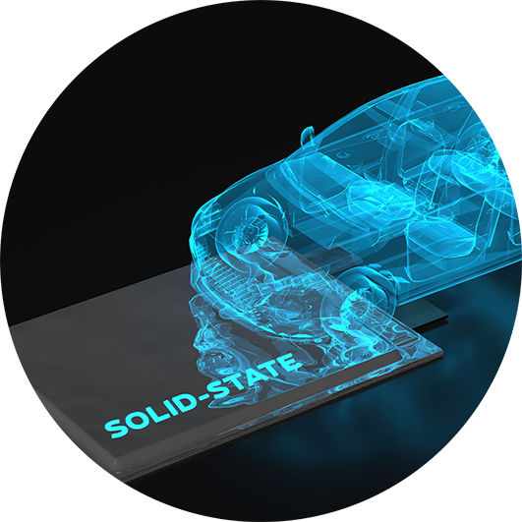
GREEN | BRAZILIAN INDUSTRY
DEVELOPING A SUSTAINABLE SOLID-STATE BATTERY INDUSTRY IN BRAZIL
PARTNERS ALREADY COMMITTED
SENAI INNOVATION INSTITUTE IN ELECTROCHEMISTRY.
THE FEDERATION OF INDUSTRIES OF THE STATE OF PARANÁ (FIEP).
COMPANHIA BRASILEIRA DE METALURGIA E MINERAÇÃO (CBMM), a large Brazilian mining and metallurgy company.
WEG, a large Brazilian maker of electric equipment.
TUPY, a large Brazilian company in the field of structural components.
BMW, a large German multinational manufacturer of luxury vehicles and motorcycles.
COMPANHIA BRASILEIRA DE LÍTIO (Brazilian Lithium Company, CBL), a Brazilian company in the underground mining of lithium.
VOLKSWAGEN, a large German car maker.

Slide 8
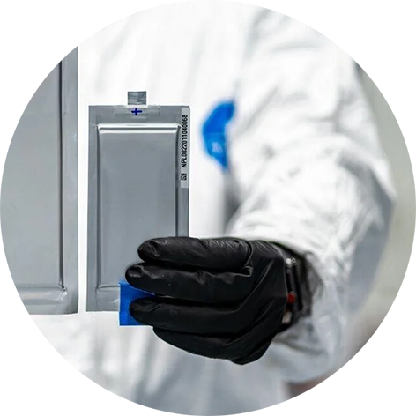
GREEN | BRAZILIAN INDUSTRY
DEVELOPING A SUSTAINABLE SOLID-STATE BATTERY INDUSTRY IN BRAZIL
KEY BENEFITS
The project will be instrumental in establishing an SSB industry, with a focus on cost-effectiveness, low GHG emissions, avoidance of cobalt, and social responsibility.
Because the electrical energy consumed in Brazil is 85 percent from renewable sources, any energy-intensive product made in Brazil is inherently greener than in many other countries.
By producing SSB in Brazil, the project will contribute to the development of a circular economy and to climate change goals.
INVESTMENT OPPORTUNITIES
Patents and royalties.
Customized project financing schemes.
Technology transfer and development cooperation support.

Slide 9
WE ARE COMMITTED TO SUSTAINABILITY AND THE REGENERATION OF THE PLANET.
To learn more: Brazilian National Confederation of Industry (CNI)
GREEN | BRAZILIAN INDUSTRY

